Slide 1
topicTHREE
Basic HTML Formatting

Slide 2
Learning Objectives
At the end of this chapter the students should be able to:
Specify different sizes of font that can be use for headings.
Apply different font formatting.

Slide 3
Introduction
This chapter will allow you to modify your font using various tags available. The main tag for font element is <font>.
Attributes for font are size, face and color.
It is a good practice to use Cascading Style Sheet to set the font color and size for the whole web pages.

Slide 4
Basic Text Formatting
<html>
<head>
<title>Basic Text Formatting</title>
</head>
<body>
<big>This text is big</big>
<br>
<small>This text is small</small>
<br>
This text contains<sub>subscript</sub>
<br>
This text contains<sup>superscript</sup>
</body>
</html>

Slide 5
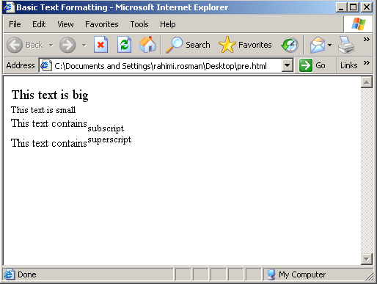

Slide 6
Making Text Bold or Italic
To improve the readability of your webpage, you might want to use bold text or italic from time to time.
Both the <b> and the <i> tags can be placed within other elements to format your texts.
They can also be used together to bold and italicize words or phrases.
It’s important to ensure that you open and close the tags in the same order.

Slide 7
Making Text Bold or Italic
The italics tags should be used to highlight a key word or phrase.
These tags are not intended to stylize or shape your font face.
Rather, use them to emphasize text or words.
The two commonly used tags to place italics onto a website are <em> and <i>.
Each of the above tags is generally interpreted by the browser in a similar way

Slide 8
Syntax | HTML | Text
<i><b> ……. <b></i> | <i><b>This text is italic & bold</b></i> | This text is italic & bold
Syntax | HTML | Text
<b> ……. </b> | <b>This text is bold</b> <b>This is bold</b>, this is normal text | This text is bold This is bold, this is normal text
Syntax | HTML | Text
<i> ……. </i> <em>…..<em> | <i>This text is italic</i> <em>This text italic</em> | This text is italic This text italic

Slide 9
Changing Size, Color, and Face of Text
Since its introduction, font tag has been the predominant means of to specify font size, face, and color on the website.
The tag to change the appearance of text is <font>.
There are three attributes of font; size, color, and face.

Slide 10
Changing Font Color
Syntax | HTML | Text
<font color = "red"> ……. </font> | <font color = "red"> This text is red</font> | This text is red

Slide 11
Changing Font Size
Syntax | HTML | Text
<font size = "16"> ……. </font> | <font size = "16"> This text size is 16!</font> | This text size is 16!

Slide 12
Changing Font Face
Syntax | HTML | Text
<font face = "Arial"> ……. </font> | <font face = "arial"> This text face is arial <font> | This text face is arial

Slide 13
Using Color
Using color in a web design is an important aspect because it will involve a favorable first impression vice versa.
It is suggested that a design should used no more than three colors in one pages and the main theme of the colors should be used throughout the entire web pages.

Slide 14
Using Color (cont.)
Although many webmaster stated that a dark background with light text is easier to be read but most Web sites are developed just the opposite of the view.
The main reasons for this is that throughout time we have written on light or white colored paper with dark colored ink and that's what we are used to.
Another reason is that the default color for a Web page is white and the default color for text is black and sometimes it's just easier to not change the colors and go with standards assignment

Slide 15
Using Color (cont.)
The main color on your page is the background color.
This color will define everything else on your page and by working around this color will decide whether your page is worthy or worthless.
To add that defining background color to your page all you have to do is add the bgcolor tag, along with the color of your choice to your page's body tag
<body bgcolor ="cyan " >

Slide 16
Using Color (cont.)
After you have decided on and added your background color to your Web site you will then need to decide on what color would most compliment it when used for your text.
If you use something similar to the background color people will not be able to see it.
You also don't want it to be too much of a contrast or it will be hard on the eyes and no one will want to read it or look at it.
Using a background image will certainly affect the contrast of the text.

Slide 17
Bgcolor
The bgcolor attribute specifies a background-color for an HTML page.
The value of this attribute can be a hexadecimal number, an RGB (Red, Green, Blue) value, or a color name:
For example:
Hexadecimal: <body bgcolor="#000000">
RGB: <body bgcolor="rgb(0,0,0)">
Color name: <body bgcolor="black">

Slide 18
W3C Standard Color Names
Aqua | Black | Blue | Fuchsia | Gray | Green | Lime | Maroon
Navy | Olive | Purple | Red | Silver | Teal | White | Yellow

Slide 19
Preformatted Text
Preformatted text between the start and end PRE tag is rendered using a fixed with font, in addition whitespace characters are treated literally.
The spacing and line breaks are rendered directly, unlike other elements, for which repeated whitespace characters are collapsed to a single space character and line breaks introduced automatically.

Slide 20
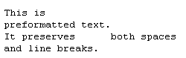
Syntax | HTML | Text
<pre>……</pre> | <pre> This is preformatted text. It preserves both spaces and line breaks. </pre>

Slide 21
Quotation Text
Quotation text can be defined using the blockquote tag.
The blockquote element is a mechanism for marking up a block of text quoted from a person or another document or source.
It may be just a few lines, or it may contain several paragraphs.

Slide 22
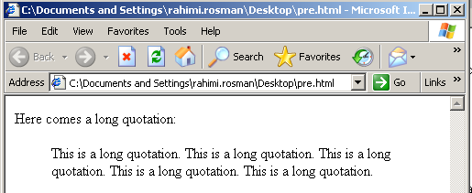
Syntax | HTML
<blockquote>……</ blockquote > | Here comes a long quotation: <blockquote> This is a long quotation. This is a long quotation. This is a long quotation. This is a long quotation. This is a long quotation. </blockquote>

Slide 23
Using Monospaced Font
One of the easiest ways to impact the design of a Web page is with the fonts that you use.
But many beginning Web designers often go crazy changing fonts every couple words and experimenting with fonts that are virtually unreadable, just because they are "cool".
The following rule of thumbs can guide you to find the font that works best for your situation:

Slide 24
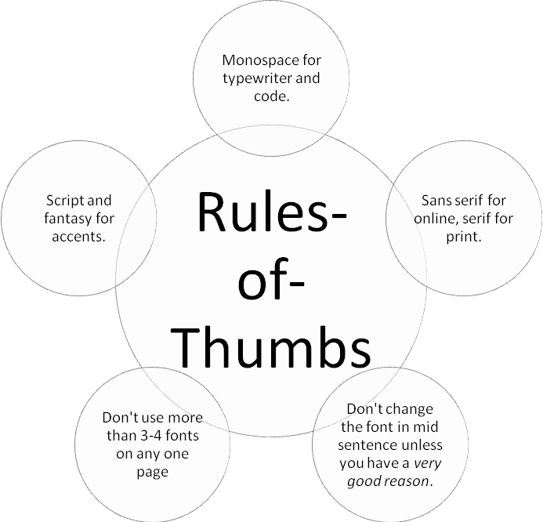

Slide 25
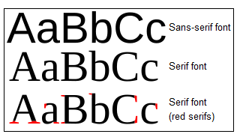
Sans-serif Fonts are the Basis of Your Site
Sans-serif fonts are those fonts that have no "serifs": the little hooks on the end of the letters.
If you've taken any print design courses you've probably been told that you should only use sans-serif for headlines.
This is not true for the Web. Web pages are intended to be viewed by Web browsers on computer monitors and computer monitors don't have as good of resolution as paper

Slide 26
Sans-serif Fonts are the Basis of Your Site
This means that when your readers view a page of serif font on the screen, the little serifs all blur together and start making the text harder to read.
Always use sans-serif fonts for your Web page main copy.
Some examples of sans-serif fonts are Arial, Geneva, Helvetica, Lucida Sans, Trebuchet, and Verdana.
Verdana is a font family that was actually invented for use on the Web.

Slide 27
Use Serif Fonts for Print
While serif fonts are hard to read online, they are perfect for print.
If you have print friendly versions of your site, this is the perfect place to use serif fonts.
The serifs, in print, make it easier to read, as they allow people to differentiate the letters more clearly.
And because print has a higher resolution, they can be seen more clearly and don't appear to blur together.
Some examples of serif fonts are Garamond, Georgia, New York, Times, and Times New Roman.

Slide 28

Monospace is for Code Examples
Even if your site isn't about computing, you can use monospace to provide instructions, give examples, or imply typewritten text.
Monospace letters have the same width for each character, so they always take up the same amount of space on the page.
Typewriters typically used monospace fonts.
Some examples of monospace fonts are Courier, Courier New, Lucida Console, and Monaco

Slide 29
Do Not Use Fantasy or Cursive for Body Text
Fantasy and cursive fonts are not as wide-spread on computers, and in general can be hard to read in large chunks.
While you might like the effect of a diary or other personal record that using a cursive font might give, your readers might have trouble.
This is especially true if your audience includes non-native speakers.
Also, fantasy and cursive fonts don't always include accent characters or other special characters which limits your text to English.

Slide 30
Do Not Use Fantasy or Cursive for Body Text
Use fantasy and cursive fonts in images and as headlines or call-outs.
Keep them short and be aware that whatever font you choose will probably not be on a majority of your readers' computers.
Some examples of fantasy fonts are Copperplate, Desdemona, Impact, and Kino.
Some examples of script fonts are Comic Sans MS, Lucida Handwriting, and Zapf Chancery

Slide 31
Superscripts and Subscripts
Superscripted text can be placed onto your website using the <sup> tag.
You may id these tags for use with Cascading Style Sheets.
You may use the subscript tags to place subscripted text onto your websites.

Slide 32
Syntax | HTML | Text
<sub>…….</sub> | This text is <sub>superscripted</sub> | This text is _{superscripted}
Syntax | HTML | Text
<sup>…….</sup> | This text is <sup>superscripted</sup> | This text is ^{superscripted}

Slide 33
Explaining Abbreviations
The abbreviation tag allows you to pass on useful information about an abbreviation without spelling it out on the page.
For example, we might use the abbreviation SDLC in a story about a system development methodology.
Some people might not know what "SDLC" means, but we can tell them without interrupting the flow of the story for those who do know the meaning.

Slide 34
Explaining Abbreviations
The appearance of the abbreviation can depend on the browser being used, but all major browsers support the abbreviation tag.
You have to add a title attribute to the abbreviation tag in order for the tool tip explaining what the abbreviation means to show up:
<abbr title="System Development Life Cycle">SDLC</a>

Slide 35
